Slide 1
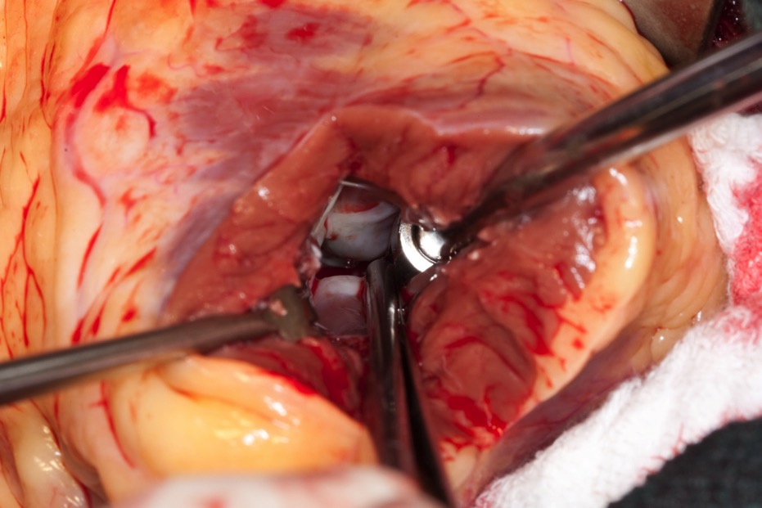

Slide 2
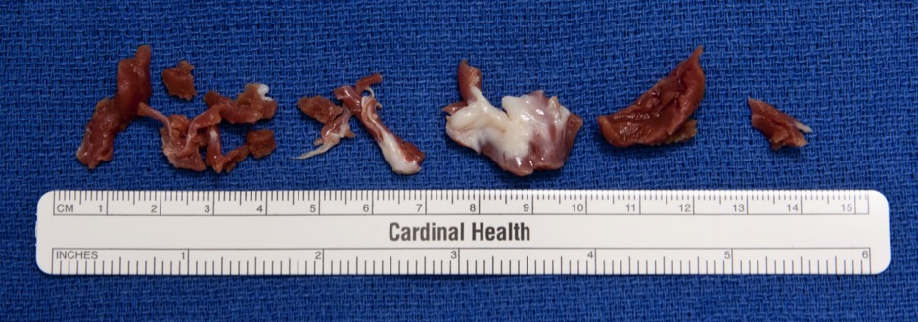

Slide 3
VIDEO

Slide 4
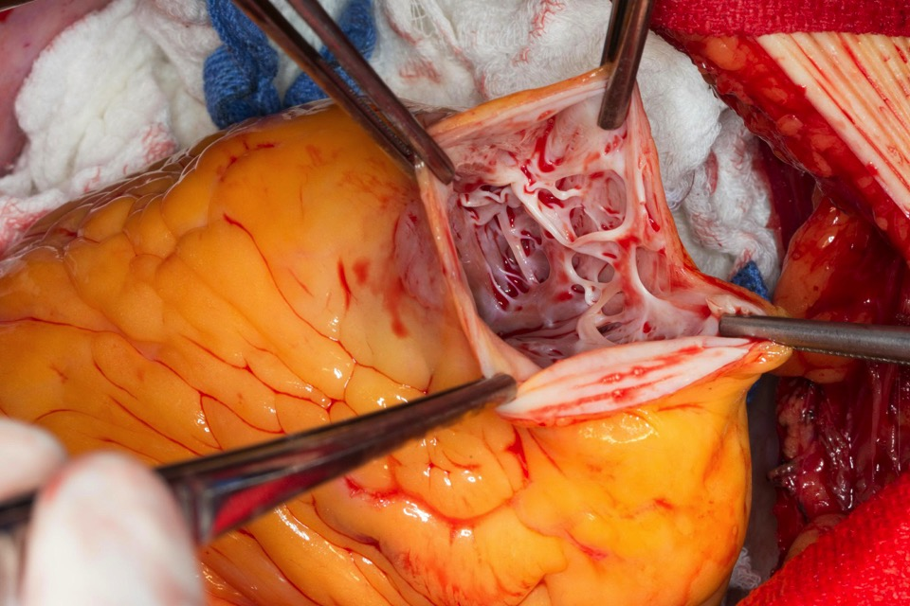

Slide 5
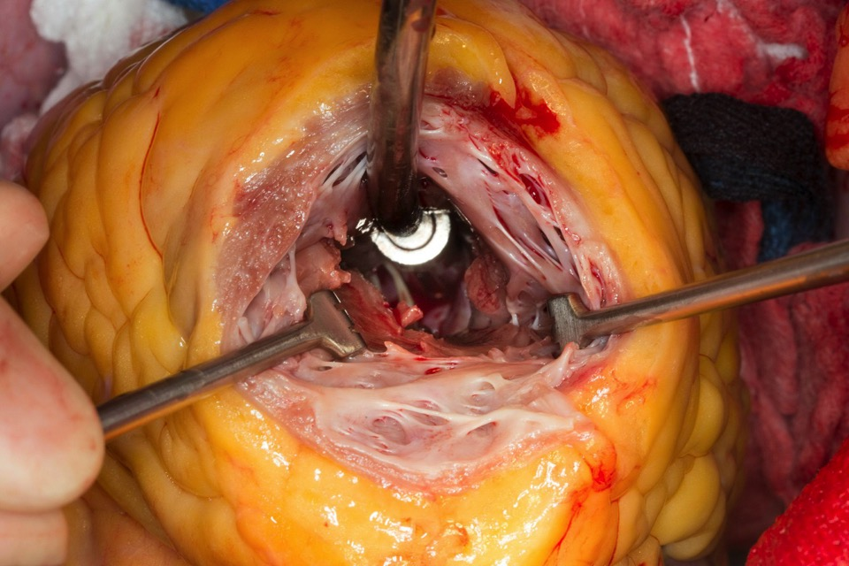

Slide 6
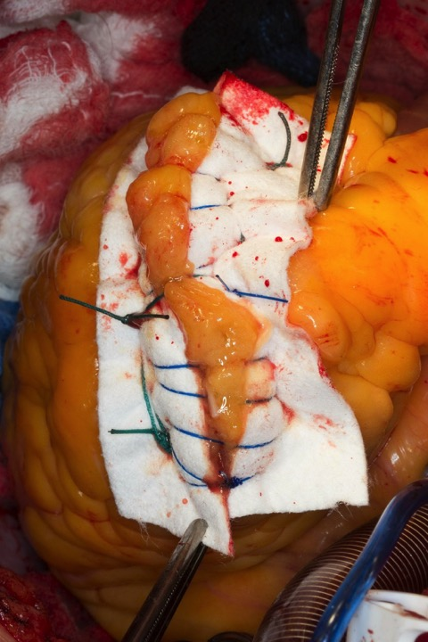

Slide 7
Mechanisms of residual obstruction Inadequate length and depth of myectomy
VIDEO
Notes:
We identified several mechanisms of failure of previous myectomies. This is an illustration showing inadequate length and depth of excision.

Slide 8
Mechanisms of residual obstruction Inadequate length of myectomy
VIDEO
Notes:
In this ilustration we have another mechanism of failure, inadequate length of excision meaning the myectomy was not carried down enough towards the apex of the heart.

Slide 9
Mechanisms of residual obstruction Midventricular obstruction
VIDEO
Notes:
Residual midventricular obstruction occurs when the has not been relief of the obstruction at the level of the papillary muscles. Obstruction at this level is typically without systolic anterior motion of the mitral valve

Slide 10
Repeat Septal Myectomy
January 1980 June 2012
2,034 total myectomies at Mayo Clinic (Roch)
n=52
Previous myectomy
elsewhere 32
Mayo Clinic 20 (≈1%)
* 1 pt had 2 redo myectomies
18
33
Notes:
Out of 2034 myectomies carried at mayo clinic during this time frame 52 redo myectomies were identified. 32 Patients had had a previous myectomy elsewhere and the rest at Mayo.

Slide 11
Results Mechanisms of residual obstruction
Inadequate length 31 (59%)
Inadequate length and depth 13 (25%)
Midventricular obstruction 6 (12%)
Inadequate length & midventricular 2 (4%)
Notes:
Mechanisms of obstruction in our population were
Inadequate length of excision 59%
Not length and depth enough 25%
Midventric obstruction 12%
And not length enough and midve 4 %

Slide 12
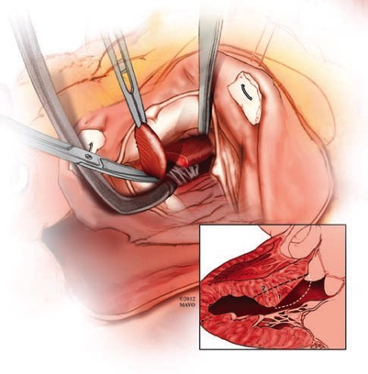
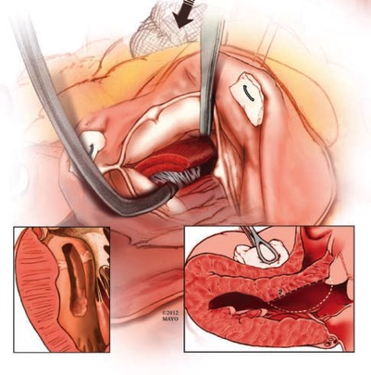
Results Surgical approach
Transaortic myectomy alone – 45 pt
Notes:
Surgical approach used to correct obstruction was an extended transaotic septal myectomy in 45 p
We can see the technique of excision that is used to address subaortic obstruction and in some case can control low subaortic obstruction and midventricular obstruction

Slide 13
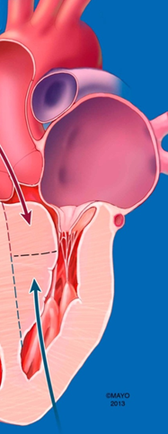
Results Surgical approach
Combined approach 3 pt
Apical alone 4 pt
Notes:
In special situations a combined approach has been used with need to approach septal hypertrophy through TA and Transapical accesses

Slide 14
Myectomy for Midventricular Obstruction Key Points
No subaortic obstruction, no SAM
Dyspnea, angina are common
Apical pouch present in 20 to 30%
Thrombus
Ventricular arrhythmias
Approach transapically

Slide 15
Pediatric Myectomy
N=187, Gradient 90 ➔ 6 mmHg
No early mortality
Morbidity
Aortic valve repair 7/127 (6%)
Mitral valve repair 2/127 (2%)
PPM 1/127 (0.7%)
Altarhabshah, Dearani, et al. Ann Thorac Surg 2013

Slide 16
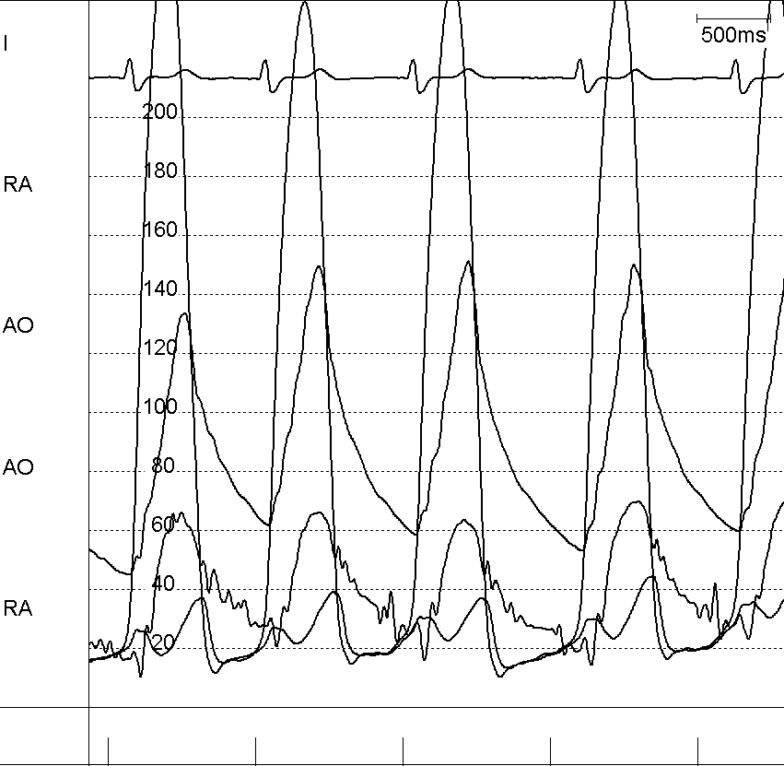
VIDEO
Fixed subaortic stenosis
5-10% of referrals
? SAM, ? AR
No response to ablation

Slide 17
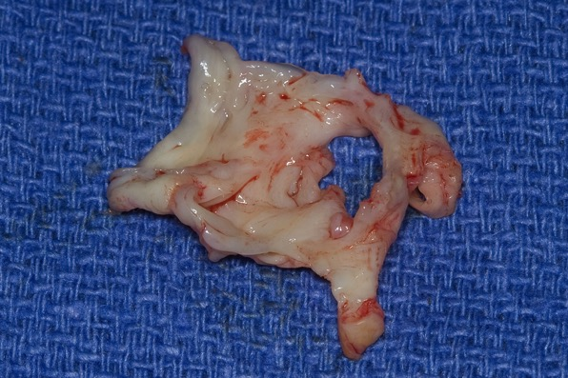
Discrete subaortic stenosis
Enucleate + myectomy
Carefully…peel off aortic valve

Slide 18
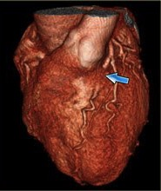
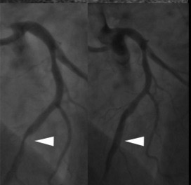
Myocardial Bridge

Slide 19
Myocardial Bridge
Retrospective case control study
36 pts (23 male); Mean age: 42 years
3 groups matched on age and gender
Group I – no surgery (n=13)
Group II – myectomy only (n=10)
Group III – myectomy + unroofing (n=13)

Slide 20
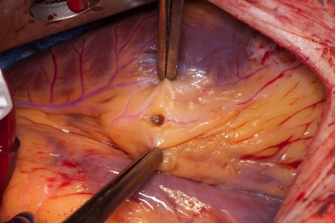
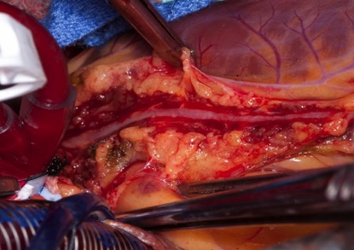
Results
Symptoms - most in Group III – angina
Myectomy: 74.1 to 5.6 mmHg
Myectomy + Unroof: 67.8 to 1.9 mmHg
Notes:
3 pts/10 pts in group 2 presented with angina compared with group 3 - 6/13 pts; Group 2; 1 out of 3 pts had return of anginal symptoms

Slide 21
Results & Summary
MB common in HCM – 15%
Unroofing – greater improvement in angina
No difference in survival
Obstructive HCM + angina ➔ myectomy + unroofing

Slide 22
What about the mitral valve?
We do...
extended septal myectomy
nothing to the MV if there is dynamic LVOTO & SAM-mediated MR

Slide 23
Myectomy (n=2,107)
Included (n=2,004)
Excluded (n=103)
(88 apical, 15 s/p MVS)
Known preop IMVD (n=99)
No preop IMVD (n=1,905)
Myectomy only 96%
(n=1,830)
Myectomy + MVS (n=99)
Myectomy + MVS (n=75) (3.9%) of 1,905)
Myectomy alone (n=1,830)
MV procedure 1.6%
With no IMVD
Intraop Dx of IMVD (n=33)
Inadvertent injury to the MV (n=12)
Minimal or no IMVD (n=30)
(1.6% of 1,905)
Hong, Schaff et al. 2015

Slide 24
Results of Myectomy & MV Procedures
Survival
P=.08
Myectomy + MVS
General population
Follow-up, y
No. at Risk
174 89 65 45 35 25

Slide 25
Results of Myectomy & MV Procedures
Survival, %
P=.002
MV repair
MV replacement
Follow-up, y
No. at Risk
Repair 133 71 50 36 30 21
Replacement 41 18 15 9 5 4

Slide 26
Survival, %
P=.63
Single CPB
Multiple CPB
Follow-up, y
No. at Risk
Single CPB 116 66 49 35 28 22
Multiple CPB 58 23 16 10 7 3

